Slide 1

Traffic Accident Analysis & Recommendations
Johnson Varghese
Parag Mehta
Ranjeet Singh Rawat
Bhavesh Vani

Slide 2
Project Overview
Organization: National Highway Traffic Safety Administration, USA
Problem statement: Deaths due to traffic accidents increased 7.2% in 2015 over 2014. This project aims to analyze the data from highway accidents and identify the causes of the increase and help find ways to prevent these deaths.
Data Source: Fatality Analysis Reporting System (FARS) that has data on fatal traffic accidents since 1975
Deliverables:
Insights into the data using visualization tools
Model to predict the number of fatalities in accidents

Slide 3
Key Data files
Approach
Merge the data
Identify data errors/outliers
Draw trends / inferences / clusters
Shortlist features for model
Create and refine model
Present inferences
Publish model
Key Questions to be answered:
Time pattern of accidents
Impact of weather conditions
Impact of distractions
Impact of impairments
Impact of drink and drugs
Impact of safety equipment
Accident (52)
Vehicle (102)
Person (68)
Distractions (4)
Impairments (4)
Factors (4)
Vision (4)
:
:
Notes:
Accident: # vehicles involved, # people involved, location, date and time, nature of accident, weather conditions, time taken for emergency services, fatalities
Vehicle: one row for each vehicle involved, # occupants, type of vehicle, make & model, hazardous goods, gross weight, speed at accident, driver licence and previous penalty details
Person: one row for each person involved, age, sex, nature of injuries, usage of restraints/air bags, alcohol/drug details
Distractions: e.g. mobile, eat/drink, audio/video
Impairments: e.g. depression, handicap, fatigue
Factors: pre existing defects or maintenance issues with vehicle that could have caused crash
Vision: Obstruction to the driver’s vision e.g. trees, glare, fog, unclean windshield

Slide 4
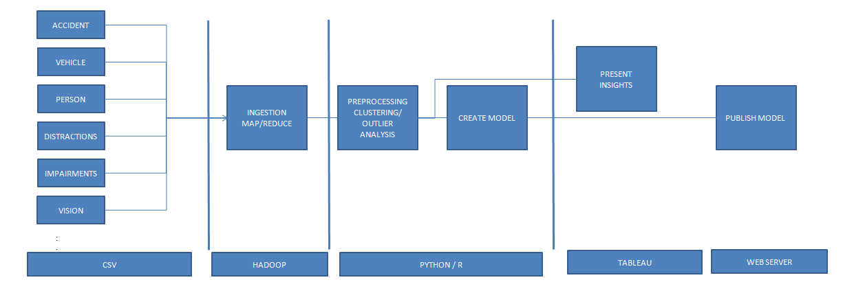
Technical Architecture

Slide 5
Timelines & Team
Schedule
Team
Milestones | Start date | Finish date
Define a problem |  | 15-Sep
Get the Data |  | 15-Sep
Explore and pre-process data | 16-Sep | 10-Oct
Create Features | 11-Oct | 15-Nov
Create Model | 11-Oct | 15-Nov
Deploy & consume model | 16-Nov | 30-Nov
Report Writing | 1-Dec | 15-Dec
Project submission |  | 15-Dec
Final presentation with project / product demonstration |  | 17-Dec
Blog publishing | 1-Dec | 18-Dec
Johnson Varghese
Parag Mehta
Ranjeet Singh Rawat
Bhavesh Vani

